Slide 1
Integrity Moments
Case Overview: BP Deepwater Horizon Oil Spill

Slide 2
Case overview
The Deepwater Horizon oil rig exploded in the Gulf of Mexico, causing the largest marine oil spill in history.
Key fact
Impact
Over 4 million barrels of oil leaked over 87 days
11 workers died, severe environmental damage

Slide 3
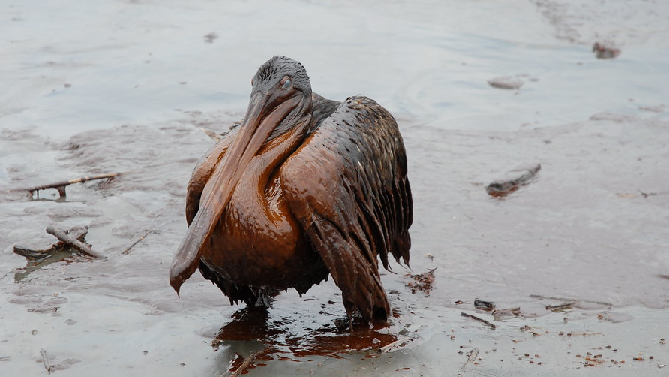
Are you communicating your sustainability efforts with transparency?
Do you seek regular feedback from stakeholders to ensure that your actions are aligned with integrity?
Reflection questions

Slide 4
Integrity Issues
BP Deepwater Horizon Oil Spill
Negligence: Failure to invest in safety measures.
Transparency Failure: BP downplayed the spill’s impact, damaging public trust.
Lack of Accountability: Corporations must own up to their mistakes.

Slide 5
Are your decisions transparent and easily explainable to others? Could you justify them if they were publicly scrutinized?
Could your personal interests influence your business decisions in a way that could compromise the company's integrity?
Reflection questions

Slide 6
Consequences
BP Deepwater Horizon Oil Spill
Outcome: BP paid $5.5 billion in federal Clean Water Act penalties and $8.1 billion for environmental damages.
Reputation: Loss of trust from stakeholders, communities, and regulators.

Slide 7
Related SDGs
BP Deepwater Horizon Oil Spill
Health impacts due to exposure to toxic substances.
Economic disruptions in fishing and tourism industries.
Need for stronger governance and accountability.

Slide 8
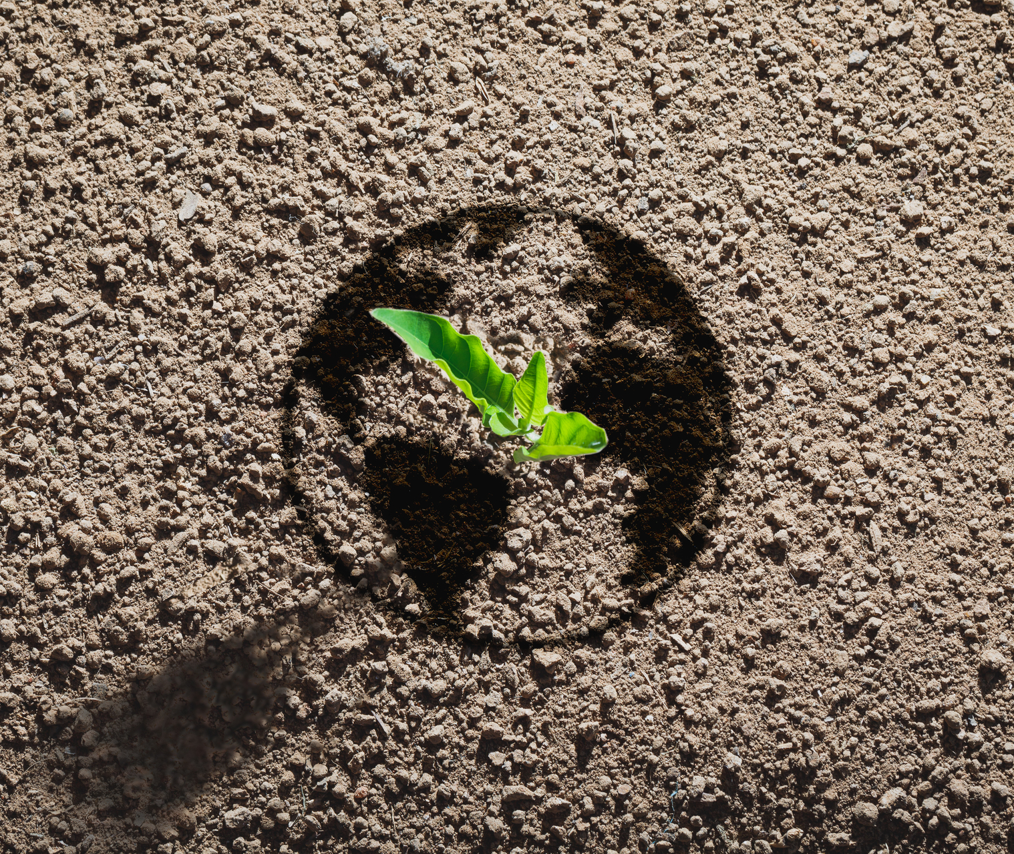
Key Learnings
BP Deepwater Horizon Oil Spill
Transparency in Crisis: Initial downplaying of the disaster worsened public trust.
Immediate Response: Slow reaction led to greater reputational damage.
Sustainability Impact: Trust, stakeholder relationships, and long-term sustainability goals were undermined.

Slide 9
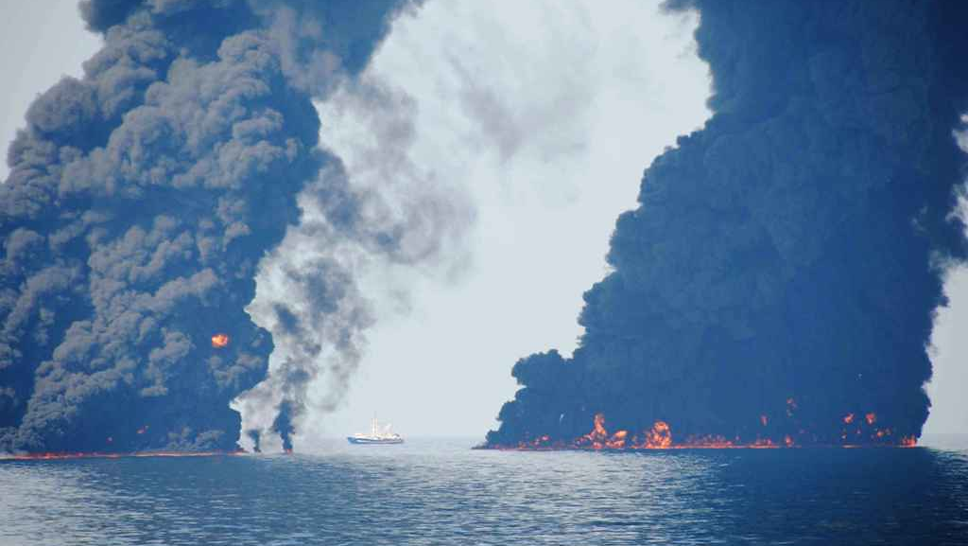
Have you communicated the reasons behind your decisions clearly to your team or stakeholders?
What steps can you take to ensure better safety measures and transparency in your operations?
Reflection questions

