Slide 1


Integrity Moments
Case Overview:
Milieudefensie et al. v. Royal Dutch Shell

Slide 2


Case overview
Environmental groups sued Shell for contributing to climate change and violating human rights due to environmental harm.
Key fact
Impact
Shell ordered to reduce CO2 emissions by 45% by 2030
Landmark decision holding a private corporation responsible for climate impact

Slide 3

How transparent are you with your stakeholders about the impact of your daily tasks to company short- and long-term goals?
Do you have an evaluation system in place for the goals of your business decisions (long term vs. short term)?
Reflection questions

Slide 4
Integrity Issues
Milieudefensie et al. v. Royal Dutch Shell
Responsibility: Can corporations be held accountable for global environmental harm?
Mismatch: Shell’s climate promises vs. actual actions.
Transparency: Lack of clarity on past emissions and future goals.

Slide 5

How do you handle situations where there is a conflict between profitability and sustainability commitments?
If a conflict of interest arises, how can you address it openly and ethically?
Reflection questions

Slide 6
Consequences
Milieudefensie et al. v. Royal Dutch Shell
Outcome: Shell must reduce emissions by 45% by 2030.
Legal Risk: Shell’s appeal could expose the board to personal liability.

Slide 7
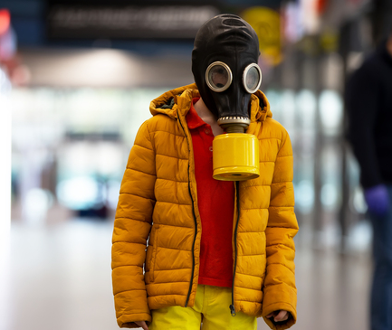





Related SDGs
Milieudefensie et al. v. Royal Dutch Shell
Health risks from emissions
Responsible consumption and production
Climate action and emission reduction

Slide 8



Key Learnings
Milieudefensie et al. v. Royal Dutch Shell
Targets:
Set specific, measurable goals for carbon reduction.
Reputation:
Overstating efforts can lead to reputational damage.
Action:
Vague promises aren’t enough; clear interim goals are needed.

Slide 9

Are you willing to be transparent about errors and take steps to correct them rather than covering them up?
What steps can you take to ensure that your company stays aligned with its environmental promises?
Reflection questions

