Slide 1
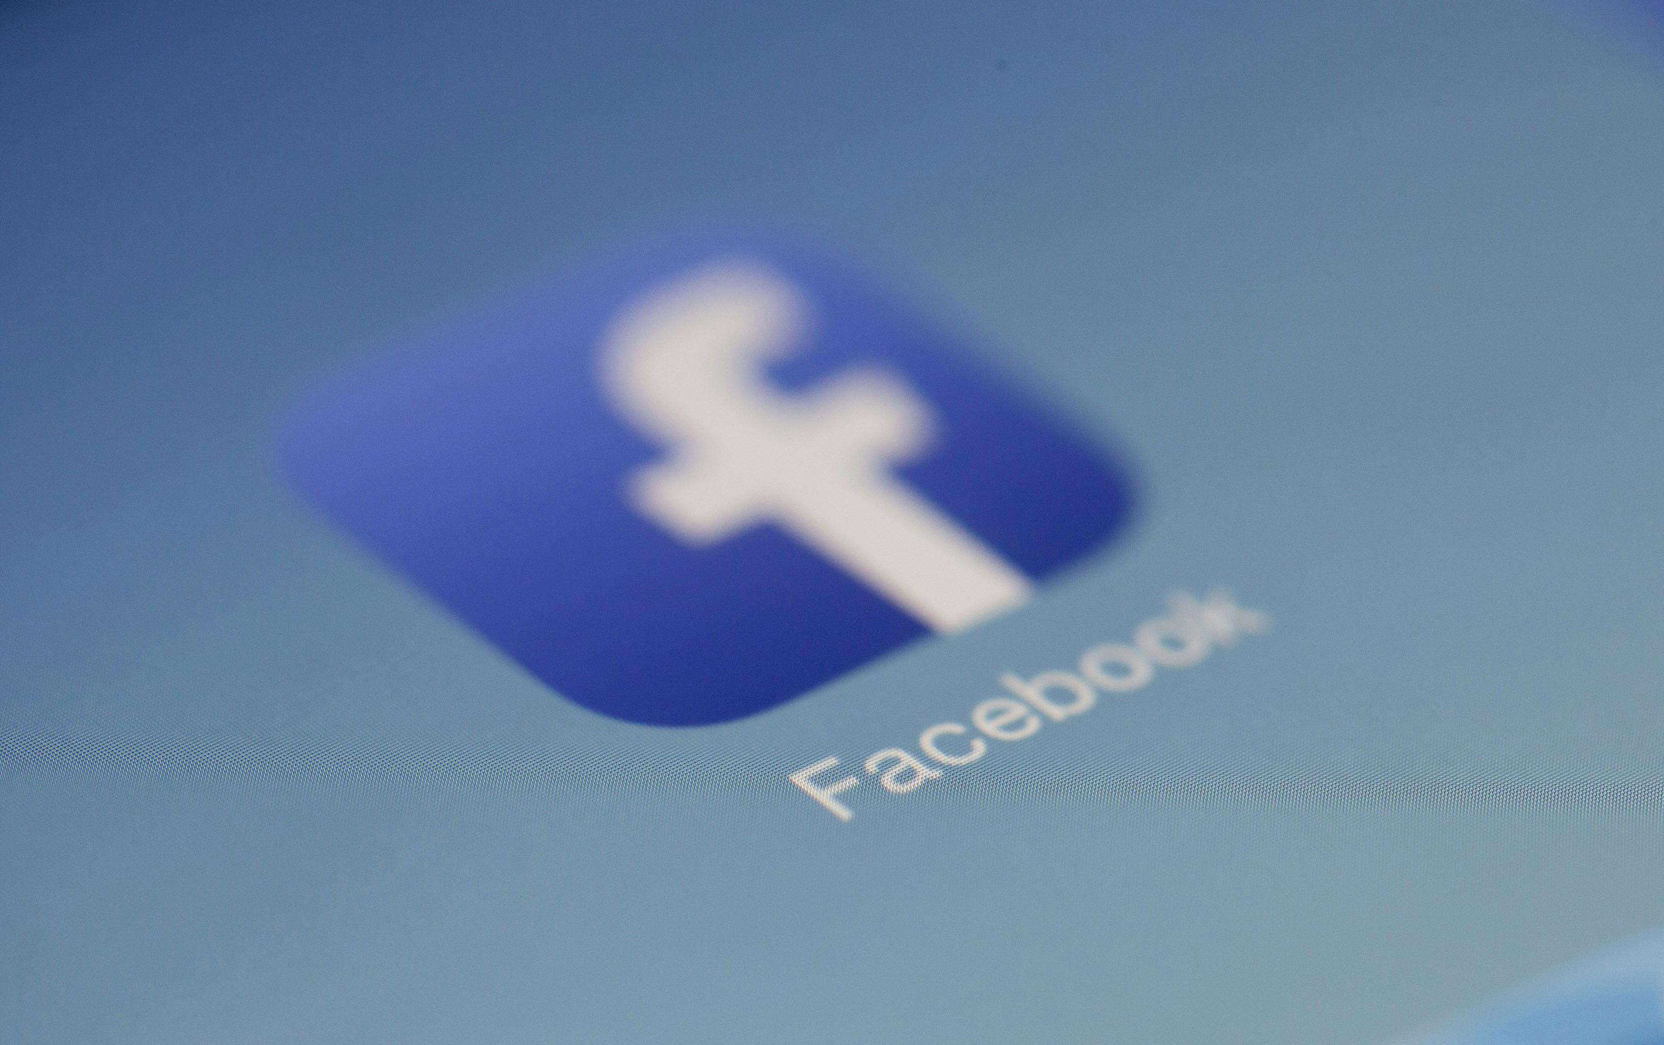

Integrity Moments
Case Overview:
Facebook-Cambridge Analytica Scandal

Slide 2


Case overview
This case involved the improper use of data from millions of Facebook users by a political consulting firm, Cambridge Analytica.
Key fact
Impact
Data harvested without user consent to target political ads and the Brexit campaign.
The Federal Trade Commission imposed penalties and fines on Facebook due to the result of the privacy violations.

Slide 3

If a person over the phone asks you to forward them personal information of a colleague, how would you proceed, and why?
Would you double check the email address from a new sender in your inbox?
Reflection questions

Slide 4

Integrity Issues
Facebook-Cambridge Analytica Scandal
Negligence: Millions of Facebook users’ data stolen without consent by a third-party, highlighting Facebook’s negligence in handling data.
Governance Failure: Facebook lacked strong data governance policies, allowing the misuse of data for political profiling and targeted advertising.
Lack of Transparency: Facebook did not initially disclose the full extent of the data breach, which eroded public, as well as consumer trust and undermined transparency in data usage.

Slide 5
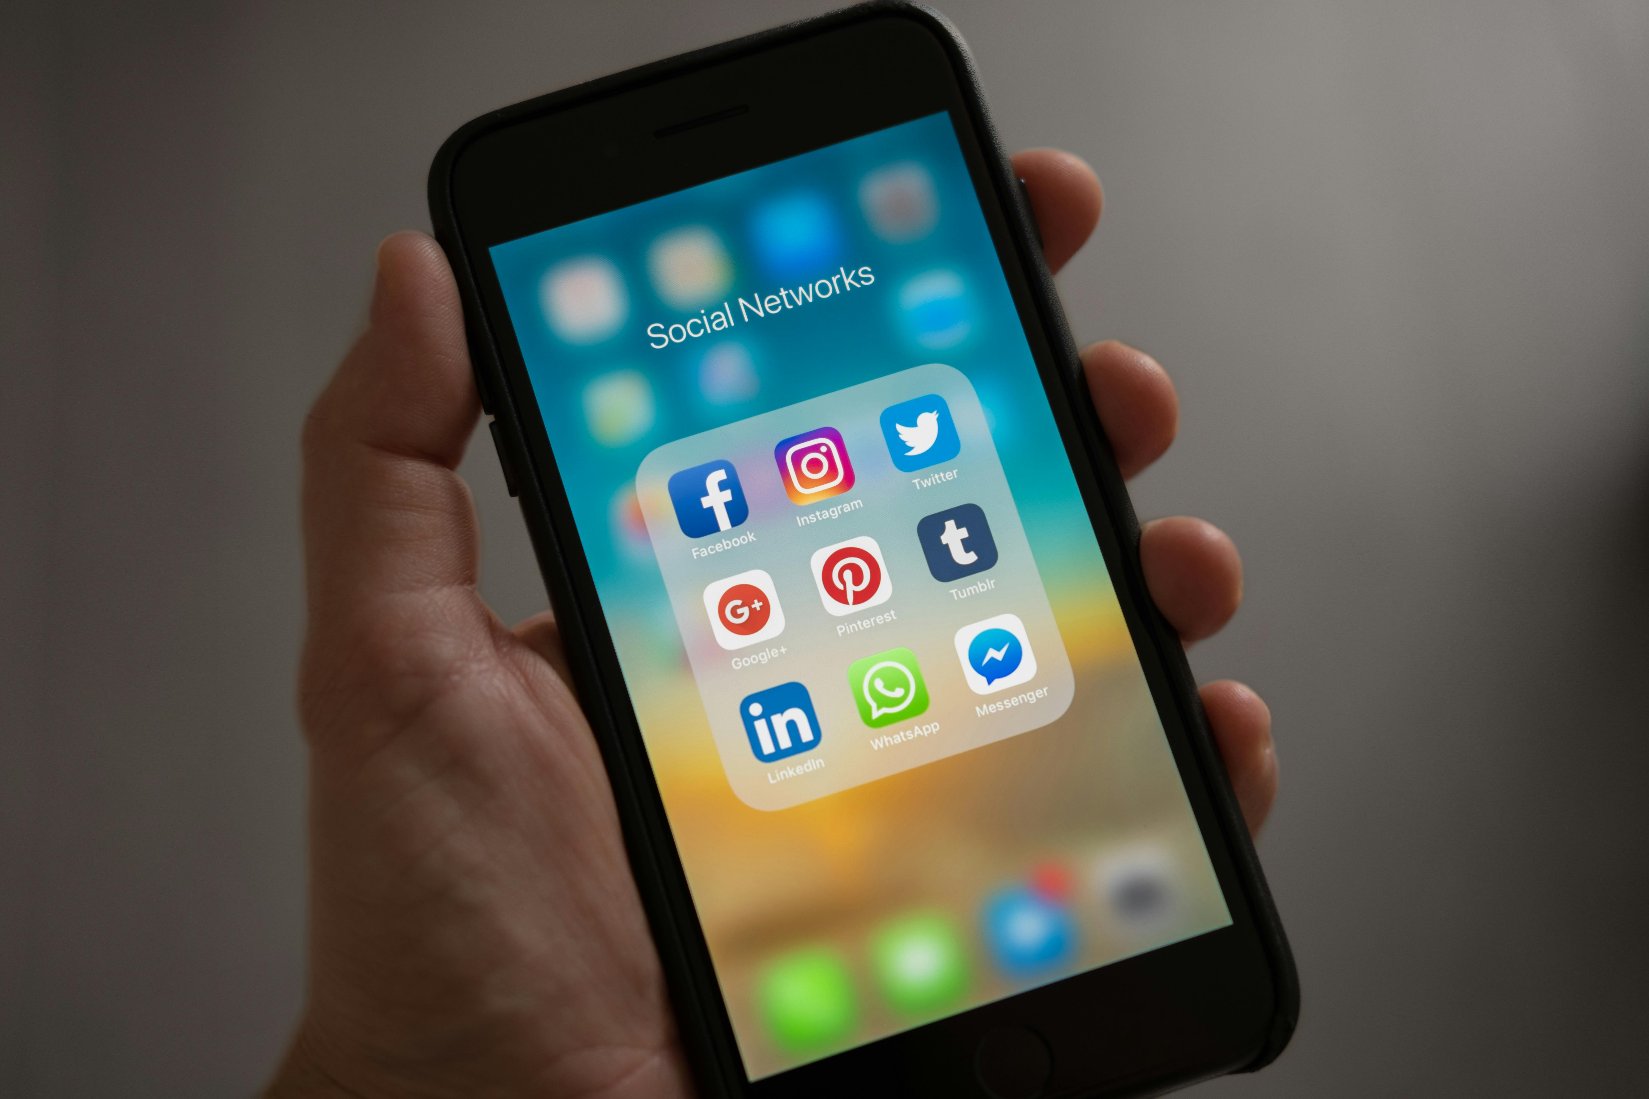
How frequently do you audit your data access policies to ensure that only authorized individuals have access to sensitive information?
What would you do if you noticed an unusual login activity on your company account?
Reflection questions

Slide 6
Consequences
Facebook-Cambridge Analytica Scandal
Outcome: FTC imposed penalties and fines on Facebook due to privacy violations. Cambridge Analytica has dissolved following the scandal.
Public response: Undermined user confidence and trust in Facebook as a social media platform.

Slide 7




Related SDGs
Facebook-Cambridge Analytica Scandal
Data can be manipulated to disproportionately influence certain socio-economic groups and political minorities.
The scandal eroded public trust in technology companies, governments, and electoral processes.

Slide 8

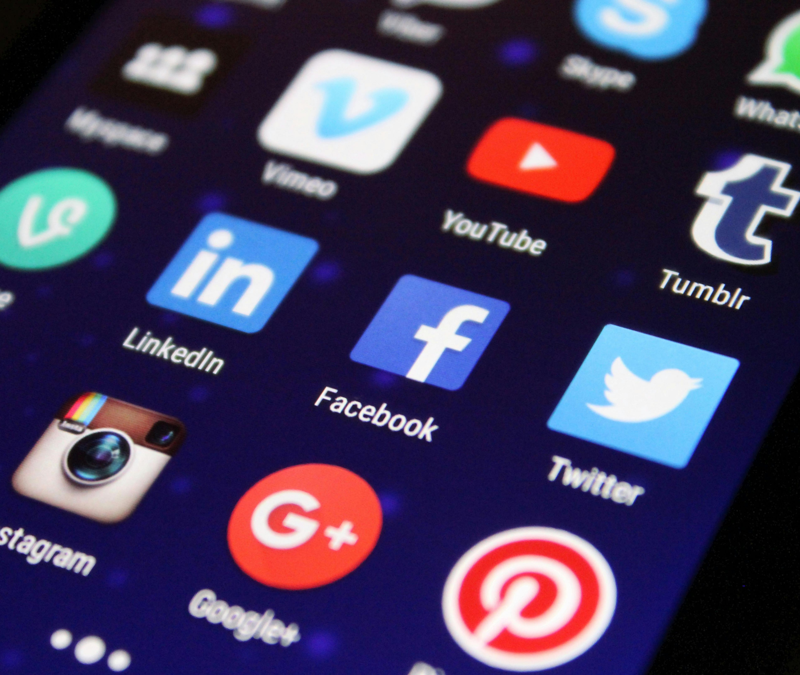

Key Learnings
Facebook-Cambridge Analytica Scandal
Transparency in Crisis:
Initial downplaying of the scandal by Facebook worsened public trust.
Third-party access:
Responsibility regarding third-party handling of user data, especially in cases where it could be used for unethical purposes, is crucial.
Data protection:
Failure to protect user data can result in massive regulatory fines and loss of trust.

Slide 9

Do you feel confident enough that you would be well-prepared to handle a data breach or breach of sensitive information in your company?
In case of a breach, how would you rebuild trust with your customers, partners, and employees?
Reflection questions

