Slide 1
Integrity Moments
Case Overview: The Wirecard Scandal

Slide 2
Case overview
Wirecard, a German digital payment processing company (fintech), was involved in one of the largest corporate fraud scandals in Europe.
Key fact
Impact
The company was found to have inflated its balance sheet by €1.9 billion, which auditors later declared to be missing.
Account falsifications, fake transactions and inflation of revenues done to maintain the company market position.

Slide 3
Do you have strong internal controls in place to prevent and detect fraudulent activities?
If a whistleblower, or an employee, detects and reports fraudulent activity, how would you respond?
Reflection questions

Slide 4
Integrity Issues
The Wirecard Scandal
Negligence: Wirecard’s internal auditing and risk management processes failed to detect or act on widespread fraud.
Transparency Failure: Wirecard falsely reported having €1.9 billion in cash reserves that did not exist. In that way, financial transparency was not ensured.
Lack of Accountability: Senior executives were implicated in the fraud, reflecting poor governance, lack of accountability, and ineffective board oversight.

Slide 5
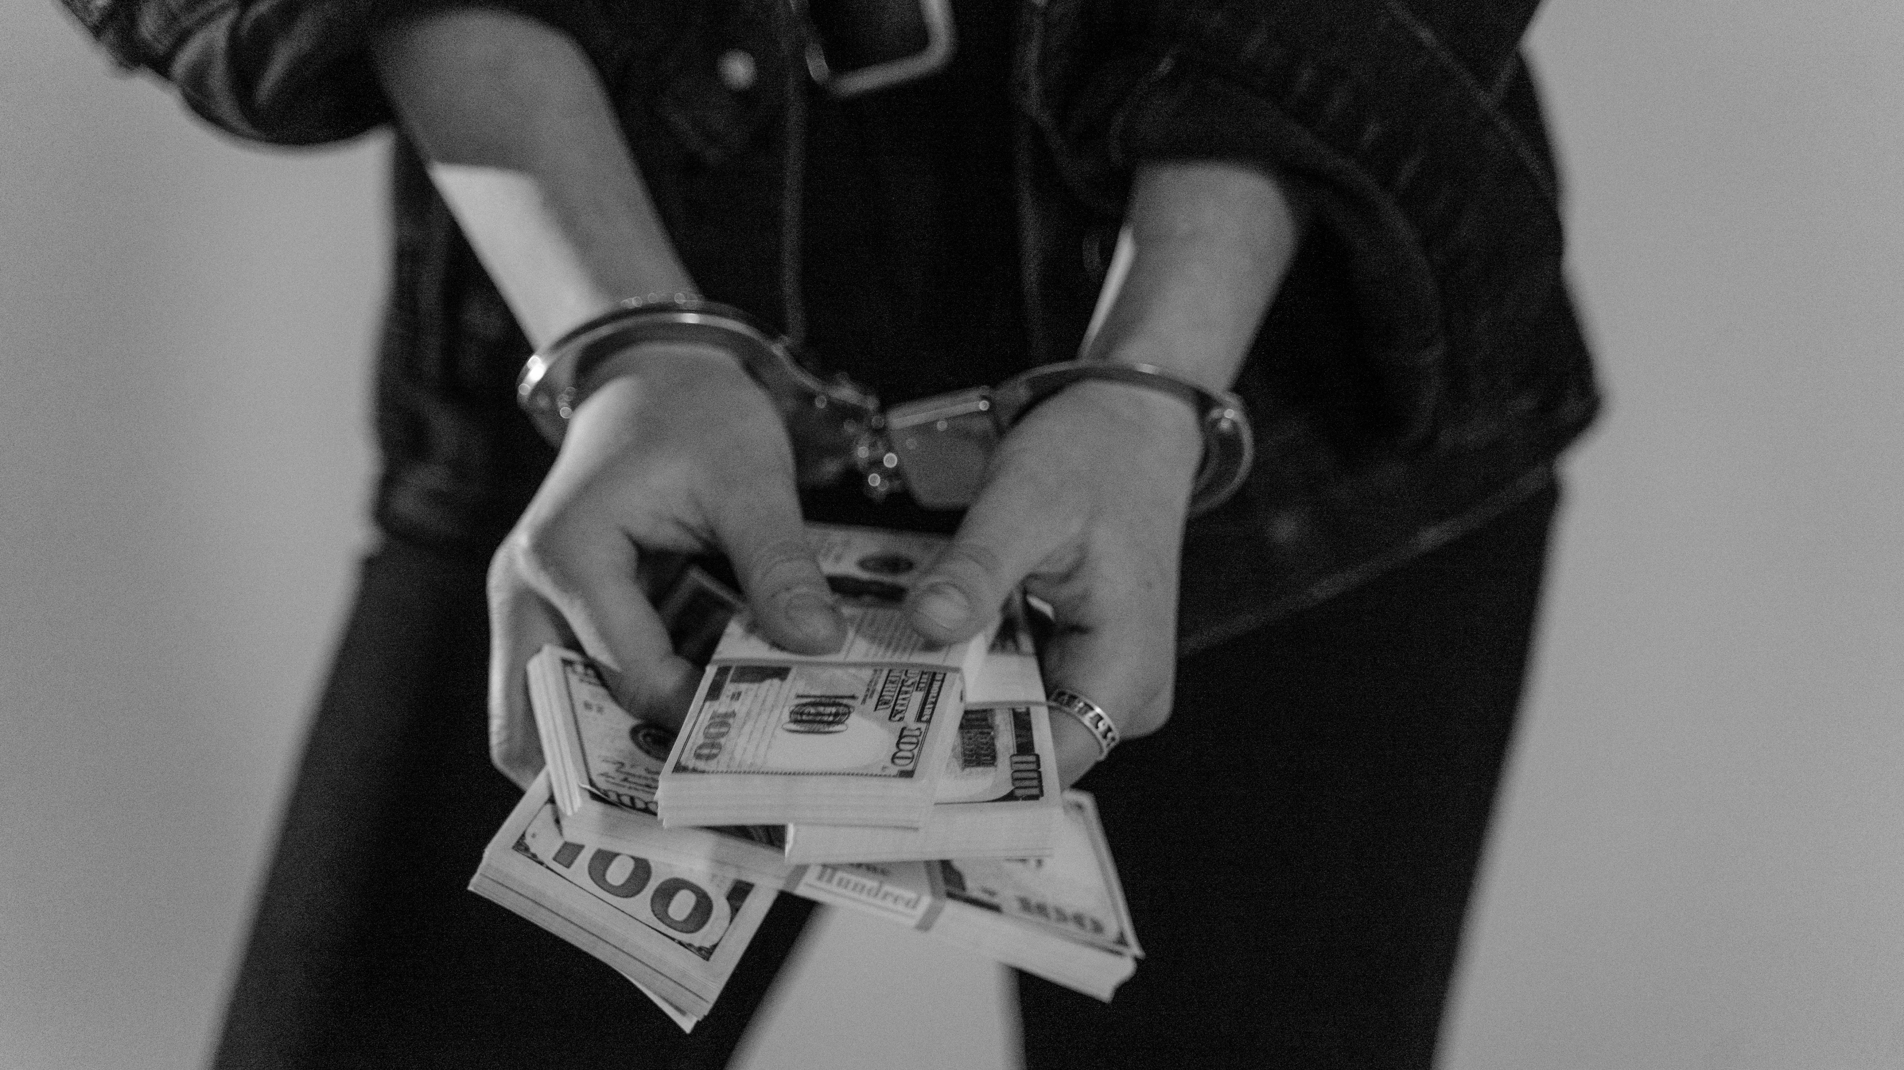
How do you ensure transparency in reporting suspicious activity?
How would you take responsibility and address a mistake while maintaining trust?
Reflection questions

Slide 6
Consequences
The Wirecard Scandal
Outcome: Imprisonment, as well as personal liability of three former Wirecard executives fined EUR 140 million in 2024 in total.
Reputation: Loss of trust from stakeholders, communities, and regulators with pending lawsuits.

Slide 7
Related SDGs
The Wirecard Scandal
The financial fraud and misrepresentation undermined trust in economic institutions and capital markets.
Systemic corporate governance failures were exposed, lack of transparency, and fraud of high levels were evident weakening trust in institutions.

Slide 8
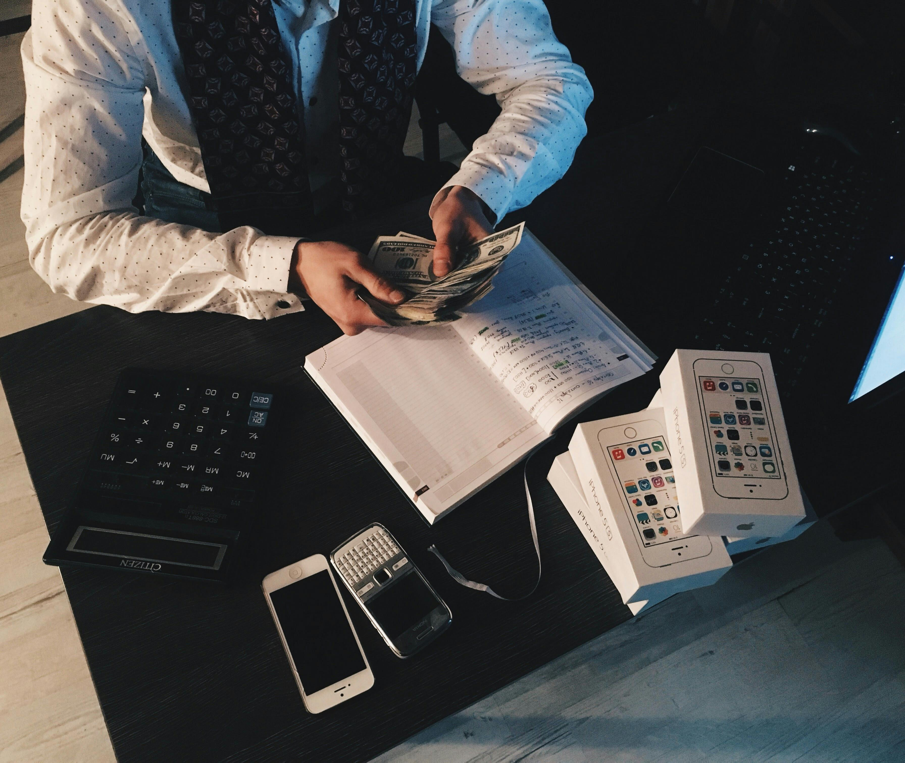
Key Learnings
The Wirecard Scandal
Undermined integrity: Fabricating or falsifying financial records undermines trust and integrity.
Accountability and oversight: A lack of accountability and oversight within senior management can lead to unsupervised misconduct.
Internal (in)actions:
Ignoring whistleblower warnings and external scrutiny, as well as through lack of maintenance of internal transparency can lead to such scandals.

Slide 9
Do you encourage colleagues to speak up when they notice unethical behavior, even if it involves senior leadership?
What would you do if a close friend or family member offered you a personal favor in exchange for selecting their company for a contract?
Reflection questions

